Slide 1
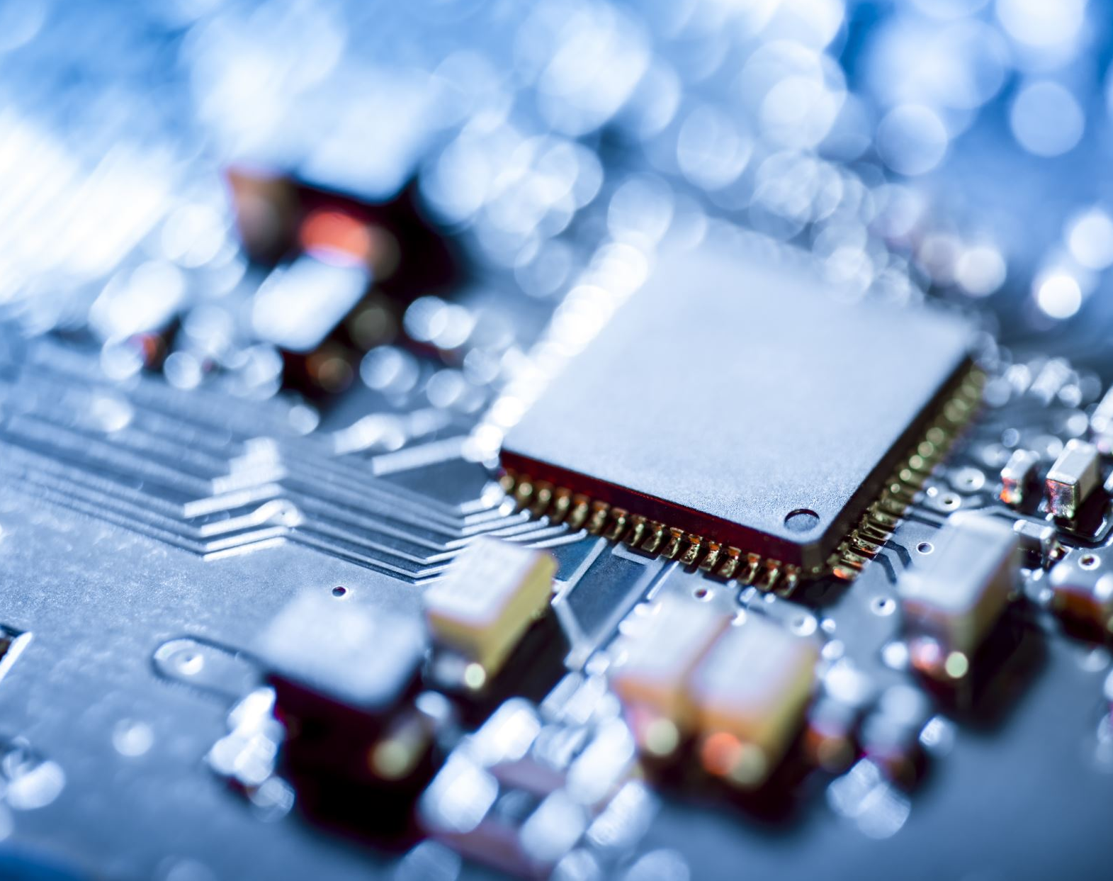
INTERFACING 16*2 LCD WITH BEAGLEBONE BLACK
PROJECT: CAR OVER SPEED DETECTION SYSTEM
SUBMITTEDBY: GOVIND RAJ
ID:C0753448
GROUP #4

Slide 2

CONTENTS
Block diagram
Introduction.
Interfacing Beaglebone black with 16x2 LCD
Schematics
Connection details
Coding steps
Conclusion
References.

Slide 3
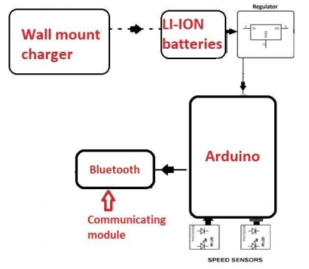
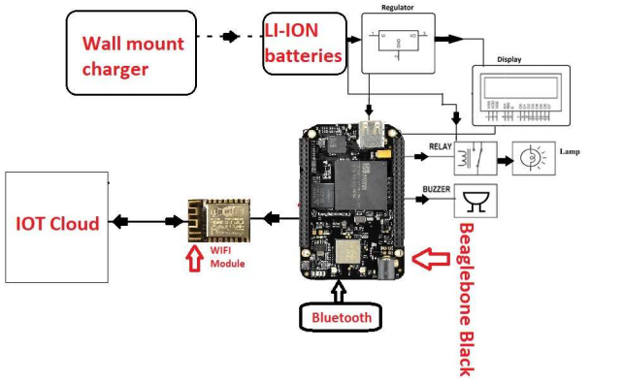
CAR OVER SPEED DETECTION SYSTEM

Slide 4

SOFTWARE AND HARDWARES USED FOR INTERFACING LCD
16*2 I2C LCD
Beaglebone black
Connecting wires
Putty
Psftp
Eclipse ,Nano editor
GCC compiler

Slide 5
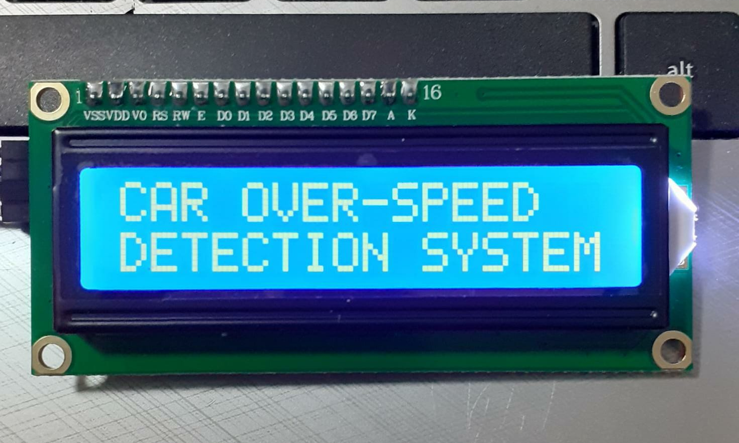
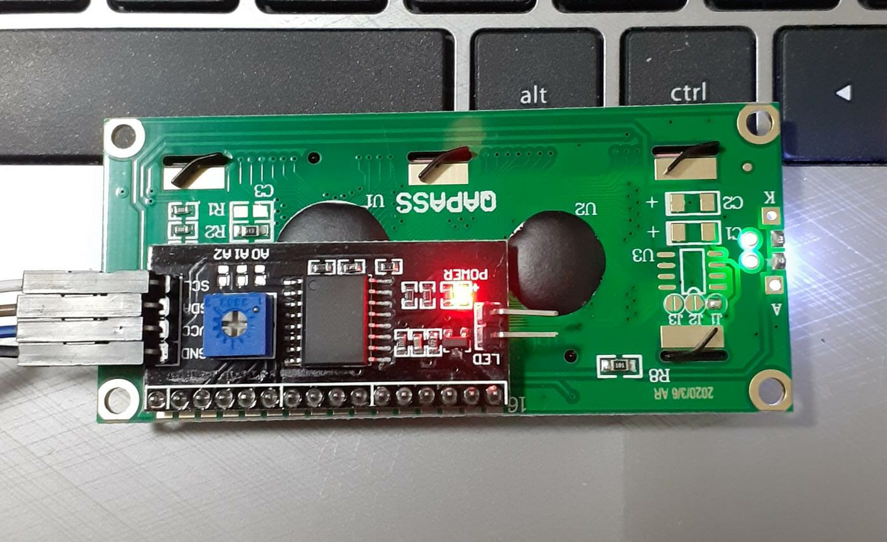
INTRODUCTION
One of the commonly used module in every embedded system projects
16*2 lcd with i2c functionality is used in this project
Operating voltage between 5V
Can display 16 characters per line and there are two such lines
LCD comes with pcf8574 module soldered.
Brightness can be adjusted with potentiometer at back of pcf8574

Slide 6
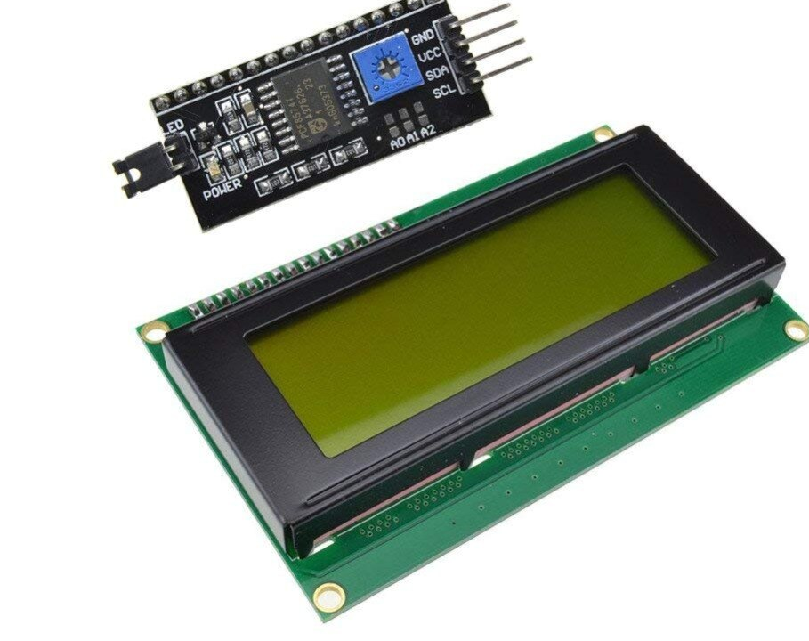
PURPOSE OF LCD IN THE PROJECT
16*2 lcd is used to display the speed of vehicle
If there is a overspeed it display that also. And also it displays the number of over-speeded vehicle between a particular period
LCD with PCF8574 module is used
It is a dot matrix type of display to display characters, symbols and numbers

Slide 7
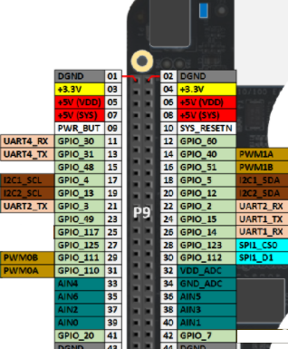
BEAGLEBONE BLACK I2C BUS
I2C is a popular communication protocol used by lots of sensors and devices.
There are three i2c buses on beaglebone black- I2C-0,I2C-1,I2C-2
The i2c-0 bus is not accessible on the header pins while the i2c-1 bus is utilized for reading EEPROMS on cape add-on boards and may interfere with that function when used for other digital I/O operations.
I2C-2 bus is free for use and we will be using that for interfacing lcd

Slide 8
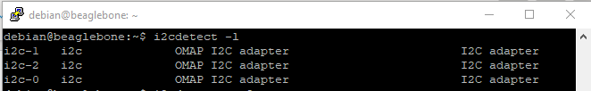
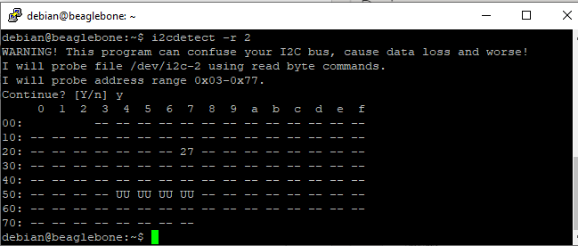
LINUX I2C TOOLS
Linux had builtin i2c tools by which we can see all the i2c busses.
"i2cdetect" is used for checking available i2c devices
"i2cdetect –r 2" command is used to detetct devices connected to i2c-2
Address shown as UU are reserved address
And there is a 27 shown it’s the i2c address of lcd which is connected to beaglebone

Slide 9
WHY DO WE NEED 4 BIT MODE?
For interfacing anything with any processor we need system-bus (data-bus, address-bus and control-bus). In normal case, for 8 bit mode the 8 data pins (D0-D7) are the data and address bus while the 3 control pins(RS, R/W and E) are the control bus. Thus using these we can control the peripheral that we are interfacing.
LCD has two kinds of interface types with MCU's: 4 bit bus and 8 bit bus. 4 bit bus and 8 bit bus are selected by DL bit of instruction register. N to select no of rows. F to select the font.
When DL="High", it means 8bit mode and when DL="Low", it means 4bit mode. Hence DL is a signal to detect 8bit or 4bit bus mode. When in 4bit mode, it needs to transfer 4bit data twice.

Slide 10
CONTD...
We want to interface as many peripherals as possible with the same microcontroller.
This requires either large number of ports or we need to be smart and utilize what we have to the fullest.
First thing is we try to do is reduce the number of pins required for controlling the peripheral. Here comes the need for 4 bit mode
In 4 bit mode we send the data nibble by nibble, first upper nibble and then lower nibble. For those of you who don’t know what a nibble is: a nibble is a group of four bits, so the lower four bits (D0-D3) of a byte form the lower nibble while the upper four bits (D4-D7) of a byte form the higher nibble. This enables us to send 8 bit data be it the ASCII code or the command code by using 4 pins

Slide 11
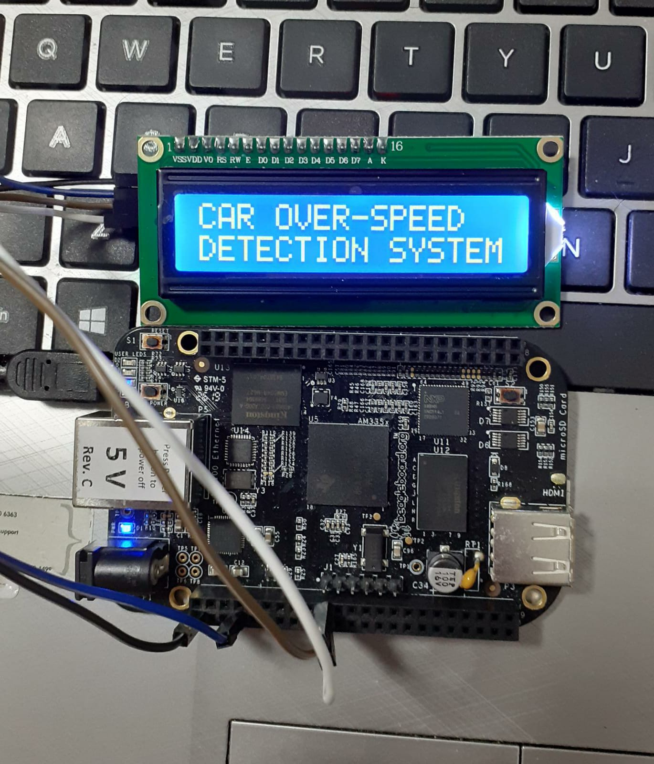
INTERFACING OF LCD WITH BEAGLEBONE BLACK
Jumper wires are used to connect lcd with beaglebone black
Potentiometer at back of PCF8574 can be used to adjust the contrast of lcd
Interfacing done in 4 bit mode as it requires fewer wires
Less wiring makes the circuit looks simpler and less complex

Slide 12
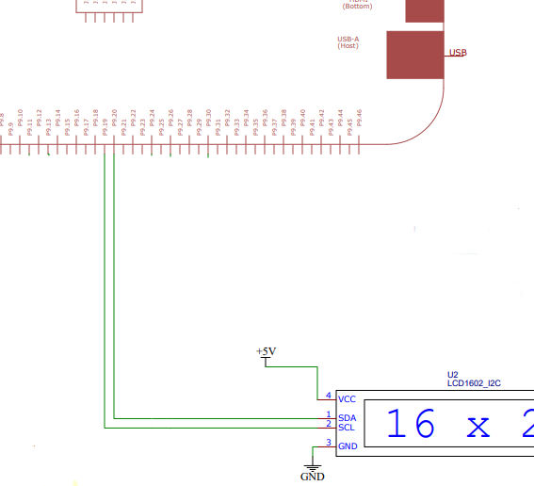
SCHEMATICS

Slide 13
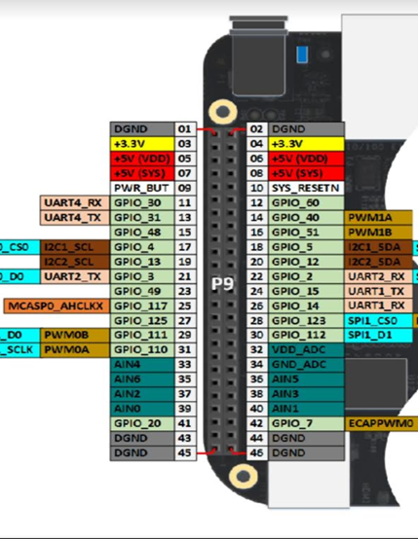
CONNECTION DETAILS
LCD connections to Beaglebone black:
Connections:
LCD | BBB
VCC | SYS 5V
GND | GND
SDA | P9_20
SCL | P9_19

Slide 14
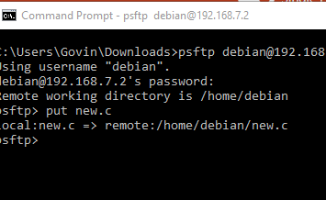
HOW TO USE PSFTP?
Here I am going to say how we can transfer files from our host machine to remote system such as beaglebone black
WinSCP is also an open source sftp client for secure transfer of files, but here I like to say how we can transfer files using psftp which is similar to sftp in linux
Download psftp.exe file and open command prompt then change the directory in which it contains program file
Use command psftp debian@192.168.7.2 and password as"temppwd" to enter into psftp interface and use put "filename" to transfer file

Slide 15
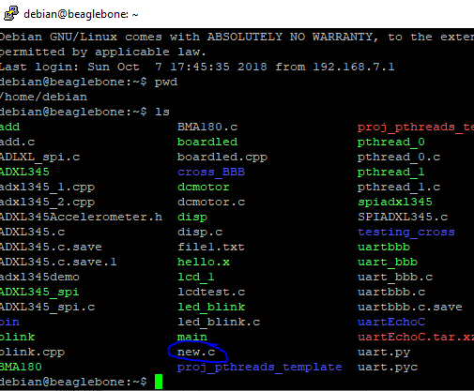
CONT..
Before using psftp open putty and log into beaglebone using its ip address, username and password
Use ls command to see all the files
After using put "filename" command in psftp.exe we can see the file inside beaglebone black

Slide 16
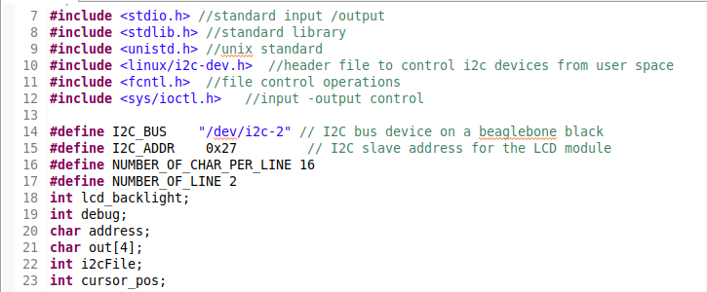
CODING STEPS
Firstly all the header files are written. Stdio.h is used for defining variable types and other input/output operations
Stdlib.h- general purpose standard library for memmory allocation,process control
Unistd.h for ulseep()
Linux/i2c-dev.h for interfacing i2c devices.
Fcntl.h is used for file operations.
Ioctl.h -implementing a device driver to set the configuration on the device
/dev/i2c-2 says we are using we are using i2c-2 device bus in beaglebone
0x27 is i2c slave address for lcd module which can be seen from "i2cdetect –r 2" command

Slide 17
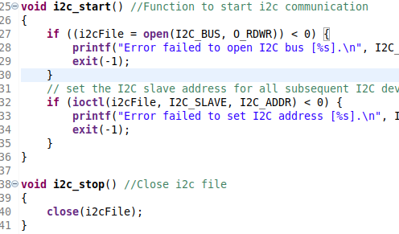
CONTD..
I2c start () is used to start I2C communication for that we open the bus in read and write mode for the communicate with devices
Open should result a value greater than zero else printf statement is processed
When you open a bus we have to specify with what address we want to communicate.(0x27)
After sending the data we can use i2c_stop() to close the file

Slide 18
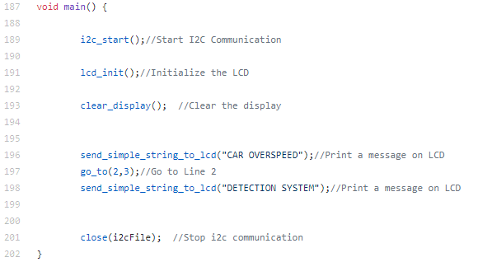
CONTD...
In main function first we start i2c communication by using i2c start()
First we should Initialize lcd
Then we should clear display
Then write the data to displayed in lcd
Goto() is used to write from particular position in lcd
Finally closing i2c file

Slide 19
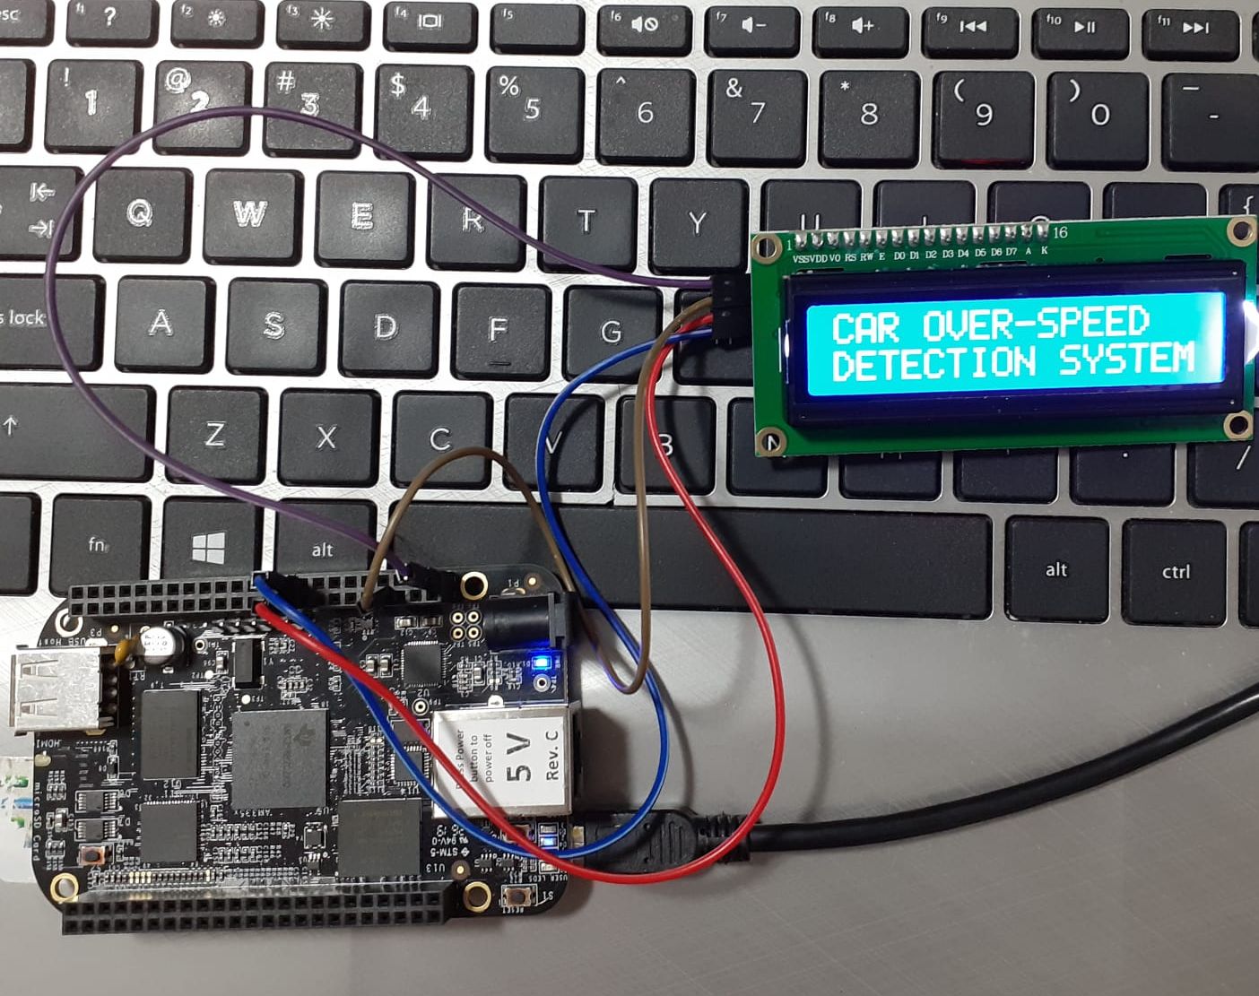
CONCLUSION
Successfully interfaced beaglebone black with 16*2 LCD uisng i2c protocol.

Slide 20
REFERENCE
Datasheet. I2C 1602 Serial LCD ModuleI2C 1602 Serial LCD Module. Retrieved from https://opencircuit.shop/resources/file/da88acc1702a90667728fcf4ac9c75c455475706466/I2C-LCD-interface.pdf
BeagleBone/I2CLCDDemo. Retrieved from https://elinux.org/BeagleBone/I2CLCDDemo
Datko, J(2013, Nov 03). Beaglebone Black I2C References. Retrieved from https://datko.net/2013/11/03/bbb_i2c/
XIAMEN AMOTEC DISPLAY CO.LTD. Specifications of LCD module. Retrieved from https://www.sparkfun.com/datasheets/LCD/ADM1602K-NSW-FBS-3.3v.pdf
Manpreet(2013, Nov 16).16x2 Lcd interfacing in 4 bit mode. Retrieved from https://learningmsp430.wordpress.com/2013/11/16/16x2-lcd-interfacing-in-4-bit-mode/

Slide 21
CONTD...
Pelayo,R(n.d).Beaglebone black i2c tutorial. Retrieved from https://www.teachmemicro.com/beaglebone-black-i2c-tutorial/
I2C devices. Enable the I2C devices on beaglebone black. Retrieved from https://sites.google.com/a/cameon.net/beaglebone/home/i2c-devices
Yoder, M. A.(n.d). EBC I2C. Retrieved from https://elinux.org/EBC_I2C
EG PRojects.(2019, June 19).Engineers Garage. How to display 5×8 and 5×10 size font characters on 16×2 lcd with 8-bit microcontrollers. Retrieved from https://www.engineersgarage.com/pic-microcontroller/5x10-size-font-characters-displayed-on-16x2-lcd/
Christian, C(2020, April 15)Element 14.pocketbeagle i2c lcd,16x2, hd44780, PCF8574. Retrieved from https://www.element14.com/community/thread/75486/l/pocketbeagle-i2c-lcd-16x2-hd44780pcf8574

